Slide 1
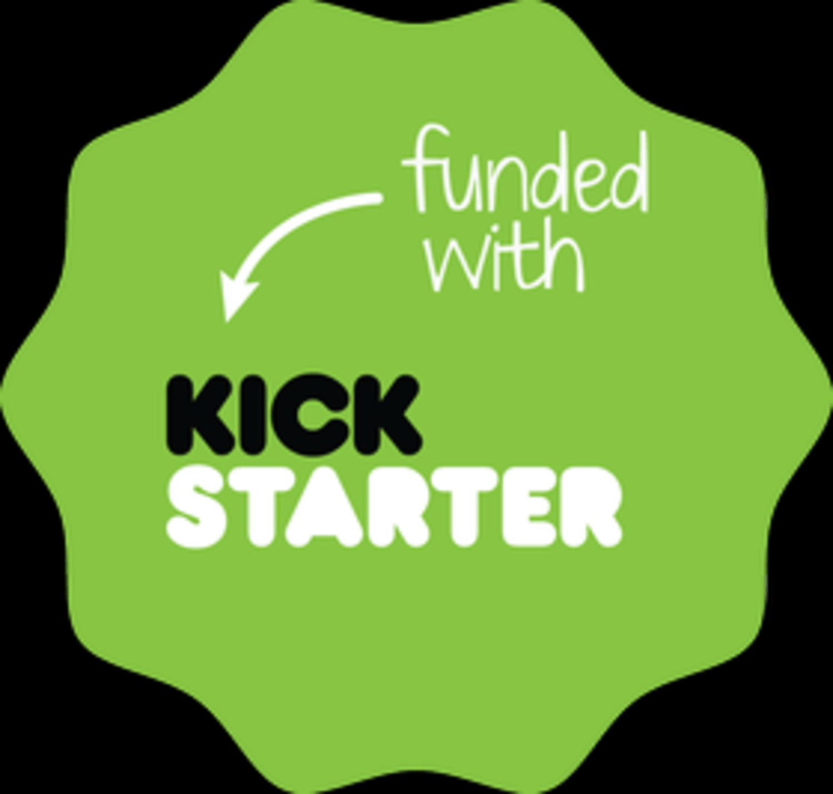

CROWDFUNDING KICKSTARTER PROJECT
Kickstarter is a funded company based in Brooklyn (United States), founded in 2009 by Yancey Strickler, Perry Chen and Charles Adler.
It enables individuals and organizations to raise funds for creative projects—such as technology, art, film, games, design, and music—without relying on traditional investors or loans.
“Understanding How Kickstarter Crowdfunding Works”
Creators launch:
A campaign by building a project page that outlines the funding goal, timeline, project description, and reward tiers for backers.
Backers Pledge Money :
Backers support the project by pledging money and selecting a reward tie.
All-or-Nothing Funding:
If the funding goal is met or exceeded, the creator receives the money. If the goal is not reached, no funds are collected, and backers are not charged.
Creator deliver Rewards:
Once the project is funded, creators complete the project and fulfill the promised rewards to backers

Slide 2




Project Creators – Group 5
Isha Peter
Simran Kumari
Geetika Sai
Sowmya Shevire
Chaitanya Tamatam

Slide 3


Project Objective
Analyze crowdfunding campaigns’ performance.
Identify trends, successes, and areas of improvement.
Utilize multiple tools for insights: Excel, Power BI, Tableau, SQL.
Visual: Simple Dashboard representing each tool.

Slide 4




Methodology
Data Cleaning : Excel/SQL.
Analysis & Visualization: Power BI & Tableau.
Key Metrics: Success rate, pledged amount vs goal, average funding per category, top-performing campaigns.
Visual: Flowchart of data → analysis → visualization.

Slide 5
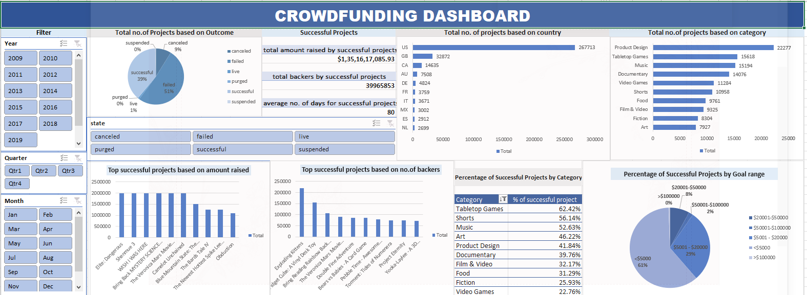
Excel Analysis
The Excel dashboard displays Total Projects by Category, allowing us to quickly identify the categories with the highest project volume and the most active creators.
  It also visualizes Total Projects by Outcome (successful, failed, canceled), providing a clear overview of overall project performance and highlighting the most common results across the dataset.

Slide 6
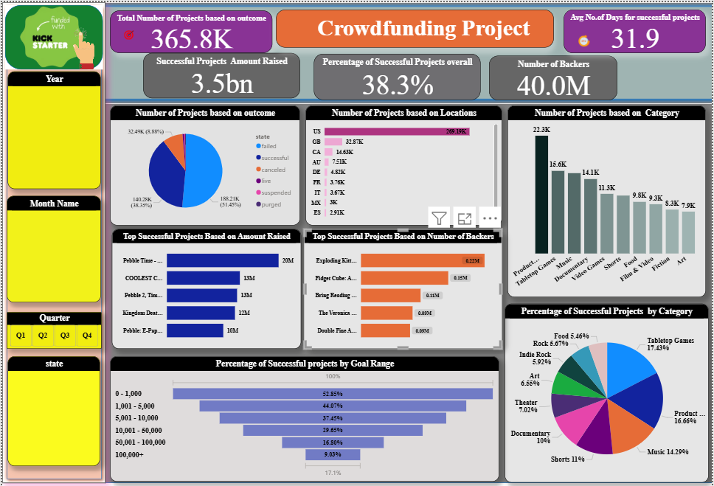
Power BI Insights
The Power BI dashboard highlights Top Successful Projects along with the Amount.
Raised, providing an instant view of the highest-funded campaigns
It also displays Top Projects by Backer Count, highlighting the ideas that attract the most support.
Received the highest level of community support.
Interactive slicers and drill-downs allow users to filter insights by category and country.
Goal range, and project status to enable deeper analysis.

Slide 7
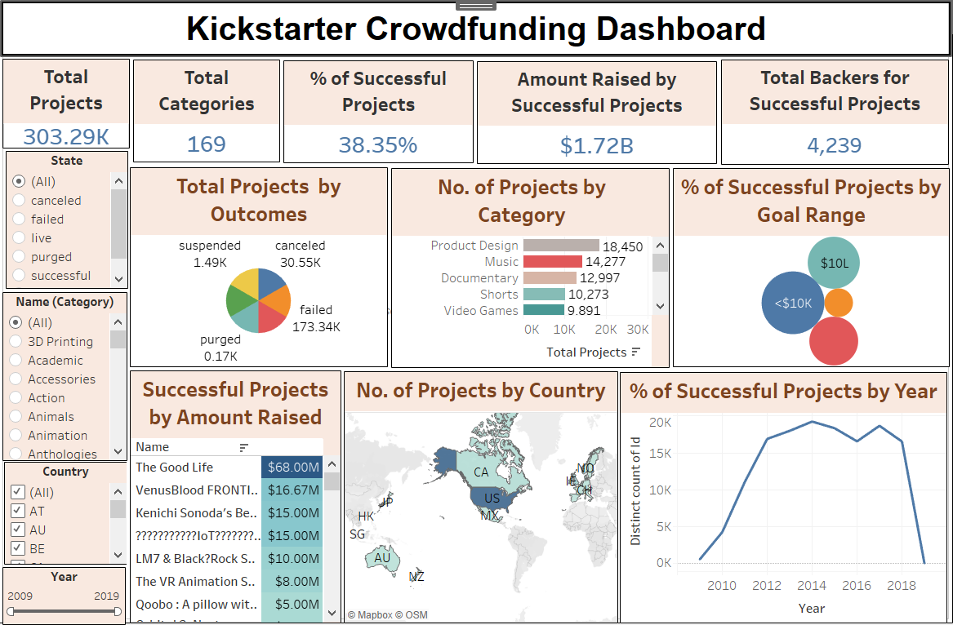
Tableau Insights
The Tableau dashboard highlights the % of Successful Projects across different Goal Ranges, making it easy to see which funding targets perform best.
It includes a Year-wise, Quarter-wise, and Month-wise trend analysis, clearly showing how project success changes over time.
Users can interact with filters for category, country, and goal range to explore deeper patterns and seasonal behaviors.
The dashboard provides a strong visual story of how timing and goal strategy impact project success, supporting better data-driven decisions
1
2
3
6

Slide 8
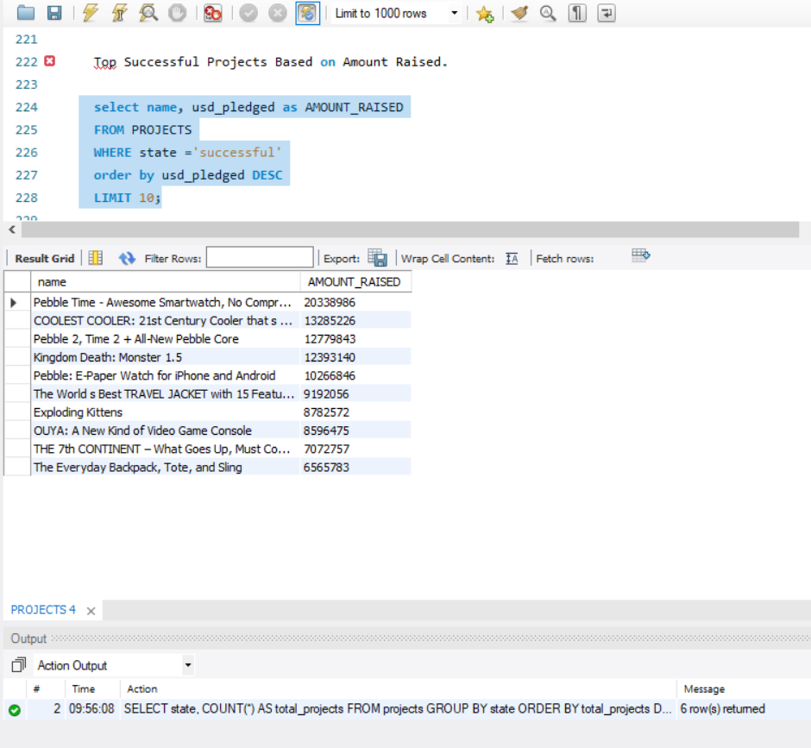
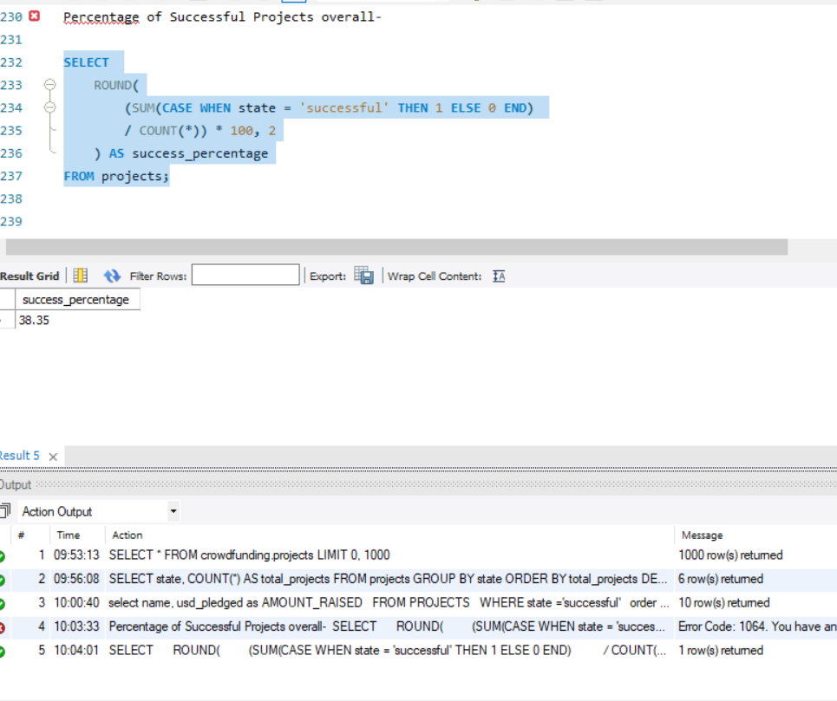
SQL Analysis
1
2
3
Querying for filtered insights: e.g., % of Successful Projects Overall & Top Successful Projects based on Amount.
Visual: SQL query snippet + small table of results
6

Slide 9
Implementation
Cleaned and prepared the dataset in Excel by converting epoch timestamps, creating a calendar table, and standardizing goal amounts to USD.
Exported the cleaned SQL dataset to Excel, Power BI, and Tableau for advanced analysis.
Built relationships, created DAX measures, and developed visual dashboards to analyze trends, project outcomes, and category performance.
This end-to-end workflow provided a comprehensive analytical view of the crowdfunding dataset.

Slide 10

Conclusion
This analysis of Kickstarter project data, using tools like Excel, SQL, Power BI, and Tableau, offers a detailed understanding of the key factors that influence project success.
SQL was used for data preparation and querying, while Excel supported detailed cleaning and initial statistical analysis. Power BI and Tableau added further value by providing interactive visualizations and dashboards that highlighted key trends, including funding performance, category-level success rates, and backer engagement.
The study showed that projects with moderate funding goals, shorter campaign durations, and compelling descriptions are more likely to succeed.
Overall, the project showed that data-driven decision-making can improve crowdfunding outcomes and highlighted Kickstarter’s role in supporting innovation, creativity, and community through a transparent and accessible funding platform.

Slide 11


Presentation by the Group -5

